Slide 1

What’s in it for me?
Reasons to be active in your state and region

Slide 2


September 26-30
Tampa, Florida

Slide 3



Follow Us
Notes:
Join us on all your social networks

Slide 4
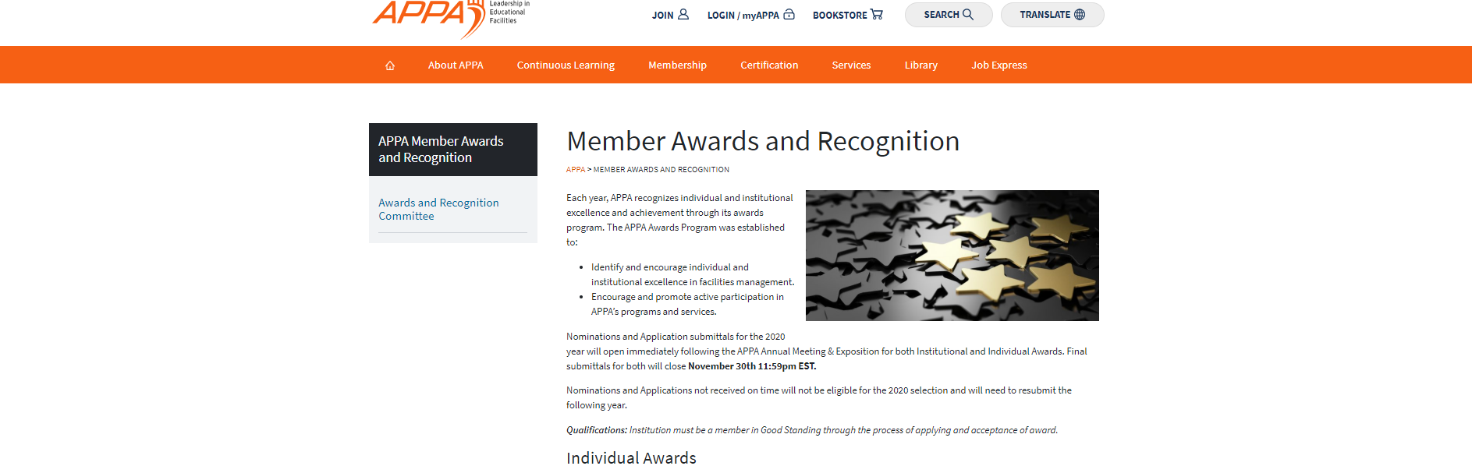
Apply for Awards & Recognition
Notes:
We want to know about your successes. Apply for all the awards if you can.

Slide 5


Education Opportunities
Leadership Academy
APPA University
Supervisor’s Toolkit
Continues Learning Series
Academy on Campus
Webinars
State, Regional, & National Conference
Notes:
Scholarships available – States were given $5,000. Also available through SRAPPA

Slide 6
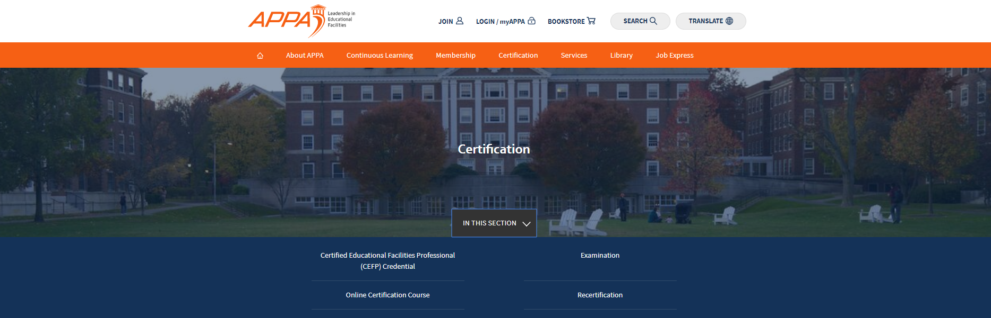

Credentialing Coupons
Notes:
We have bought down the price of the exam.
SRAPPA Members can now take the EFP exam for $450 (an $1100 value) and the CEFP for $550 (a $1300 value).
This offer is available only to institutional members of both APPA and SRAPPA.
The SRAPPA Board has voted to approve an even greater discount by offering a refund of $150 for those taking and passing the CEFP exam.

Slide 7


Networking Opportunities
Conference
Education Programs
Mentors
Drive-in Workshops
Special Groups
  K-12
  HBCU
  Community Colleges
  Young Professionals

Slide 8

Other Resources
Facilities Management Evaluation Program
Standards and Codes
Facilities Performance Indicators (FPI)
Body of Knowledge (BOK)
Facilities Manager Magazine (now online)
Thought Leadership Series

Slide 9
Notes:
He was the most popular speaker at the 2018 Conference and is back for a limited time – two session on October 10 only.

